Slide 1
Food Waste
The Type of Food in Household and Retail Waste?
By: Nyanchiew Malual Ruot

Slide 2
Introduction.
Food waste is define as “food that is intended for food consumption but is discarded, lost, or uneaten at various stages of the supply chain.”
Food waste is a big issue in the world and with significant social, economic environment consequence. Food waste occurs in every stage from production distribution, retail and household.

Slide 3
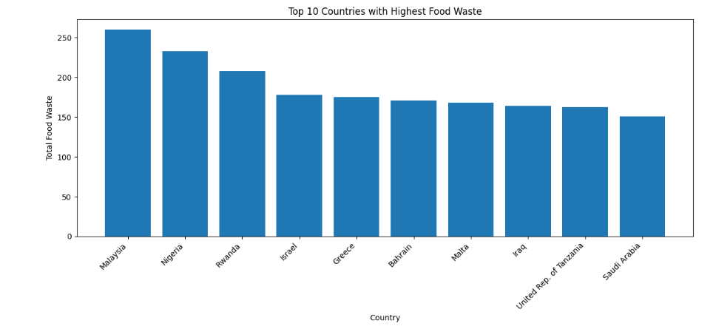
Which Country has the most food waste
These are the top 10 food waste countries where Malaysia lead number one.
This food waste could be because of consumers over purchasing and lack of knowledge of food waste in their country.

Slide 4
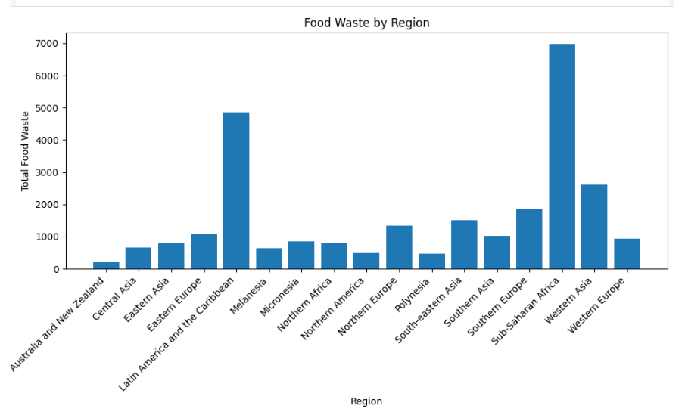
Which Region has the least food waste?
Region | Amount of Waste
New Zealand | 0
Polynesia | 478
North America | 0
According to the dataset these are the least food waste in these 3 regions.

Slide 5
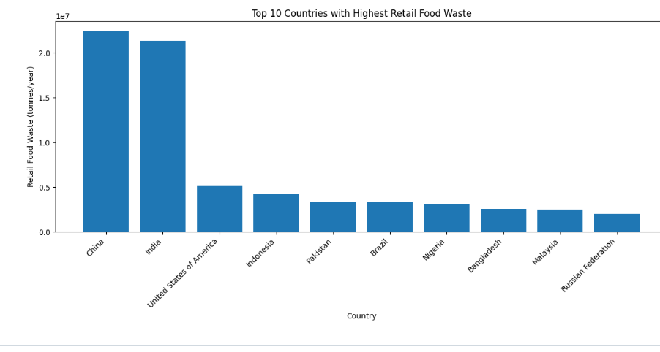
Which two Regions have the highest Retail Waste?
China #1
Indonesia #4
India #2
USA #3

Slide 6
Inconclusion
Malaysia has a huge issue when it comes to food waste. The USA, China, and India are highlighted for the large overall retail waste contribution. New Zealand and Polynesia tend to report lower food waste, but the date can be limited .

Slide 7
Sources
https://www.kaggle.com/datasets/joebeachcapital/food-waste/data
https://www.wri.org/insights/reducing-food-loss-and-food-waste

Slide 8
Add a Slide Title - 3

Slide 10
Add a Slide Title - 4

Slide 11
Add a Slide Title - 5

